Slide 1



Presented by Rajashree Gavali Kamble
ANALYSIS OF CUSTOMER CHURN
Analyzing Factors Contributing to Customer Churn and Building Predictive Models
Date: 29 Aug 2024

Slide 2



Project Overview
Objective:
Analyze customer data to identify key factors contributing to customer churn.
Build predictive models to forecast future churn.
Provide actionable recommendations to reduce churn.
Dataset: Telco Customer Churn dataset from Kaggle.

Slide 3


Problem Statement
Analyze customer data to identify factors that contribute to customer churn (i.e., customers leaving the service) and build a model to predict future churn.

Slide 4
Data Overview
Dataset Description:
Number of records: 7043
Number of features: 33
Key Features: Customer demographics, account information, subscription services, churn status.

Slide 5


Data Cleaning in Excel
Checked for missing values in the dataset.
Conducted basic data cleaning and preprocessing.

Slide 6
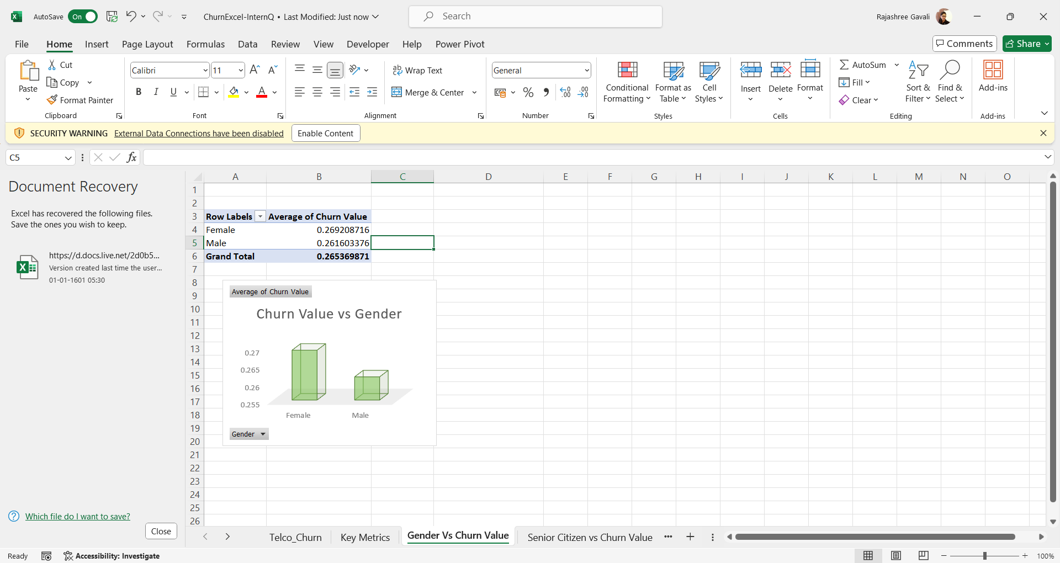
Initial Data Exploration in Excel
Created Pivot Tables to summarize key metrics:
Average Tenure Months
Average Monthly Charges
Churn value by Gender

Slide 7

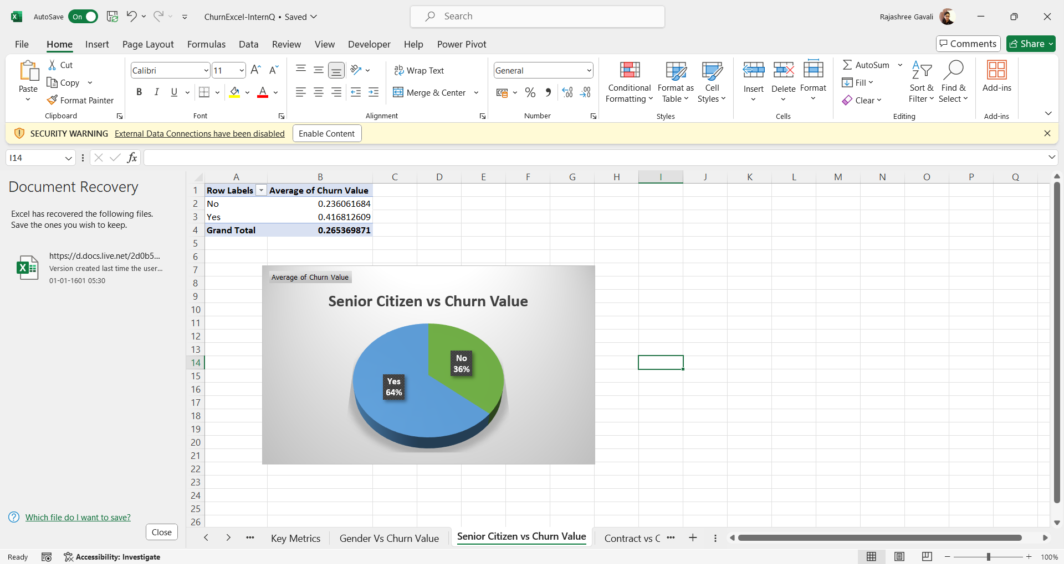
Churn by Senior Citizen
The churn value vs senior citizen clearly shows, it is directly proportional to one another. This chart is obtained using a pivot table.

Slide 8

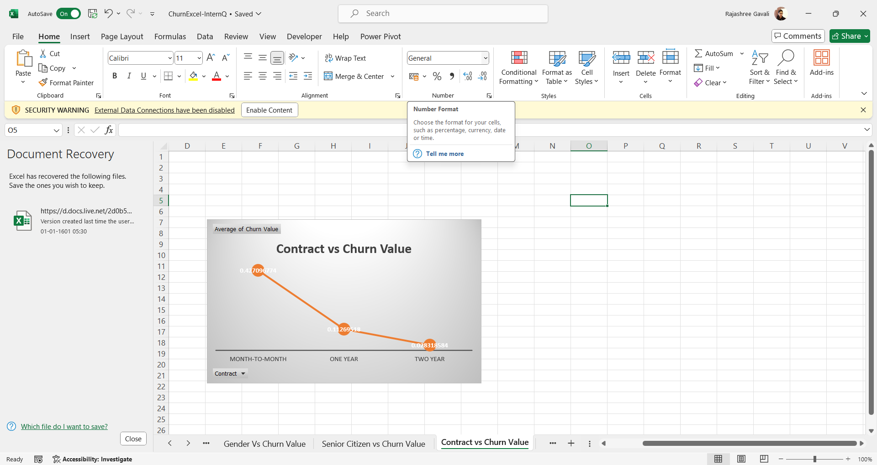
Contract by Churn
The churn vs Contract is plotted using a Line chart. Here, the churn value of contract month-to-month is highest

Slide 9
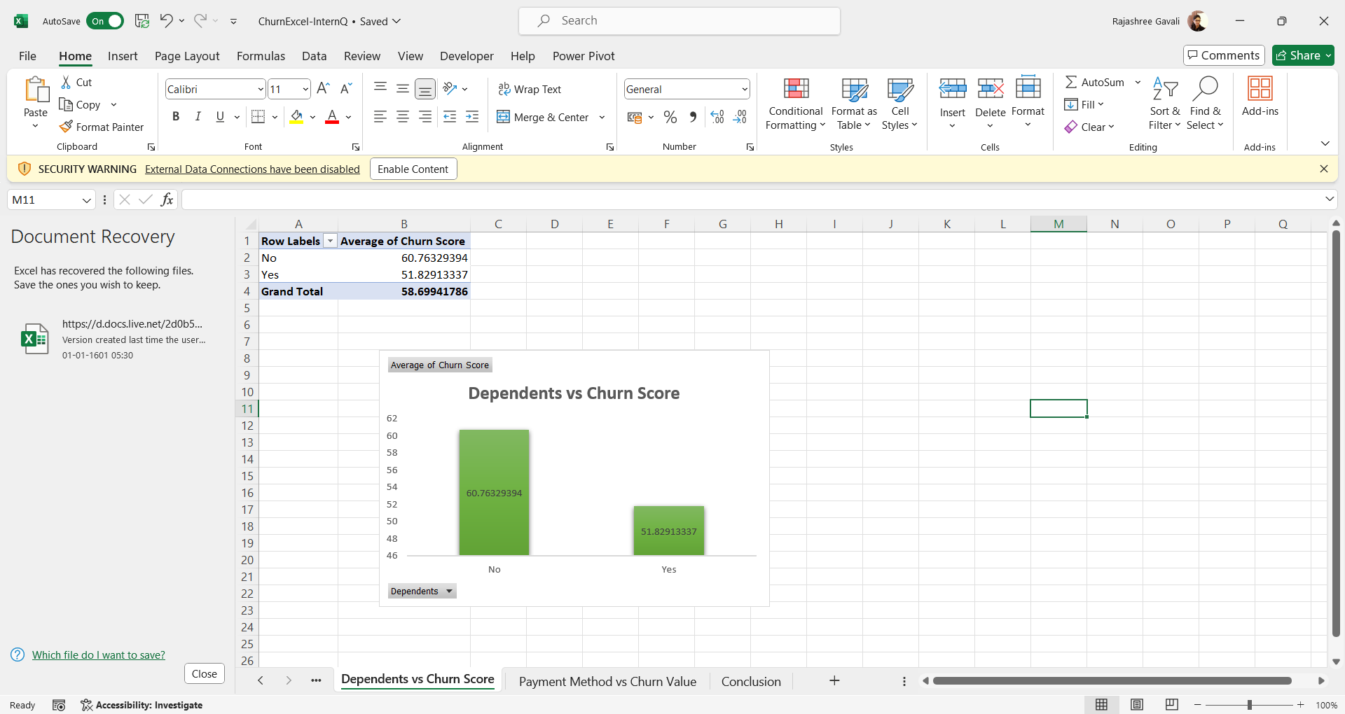
Churn by Dependents
The churn rate vs dependents clearly shows, it is directly proportional to one another. This chart is obtained using a pivot table.

Slide 10
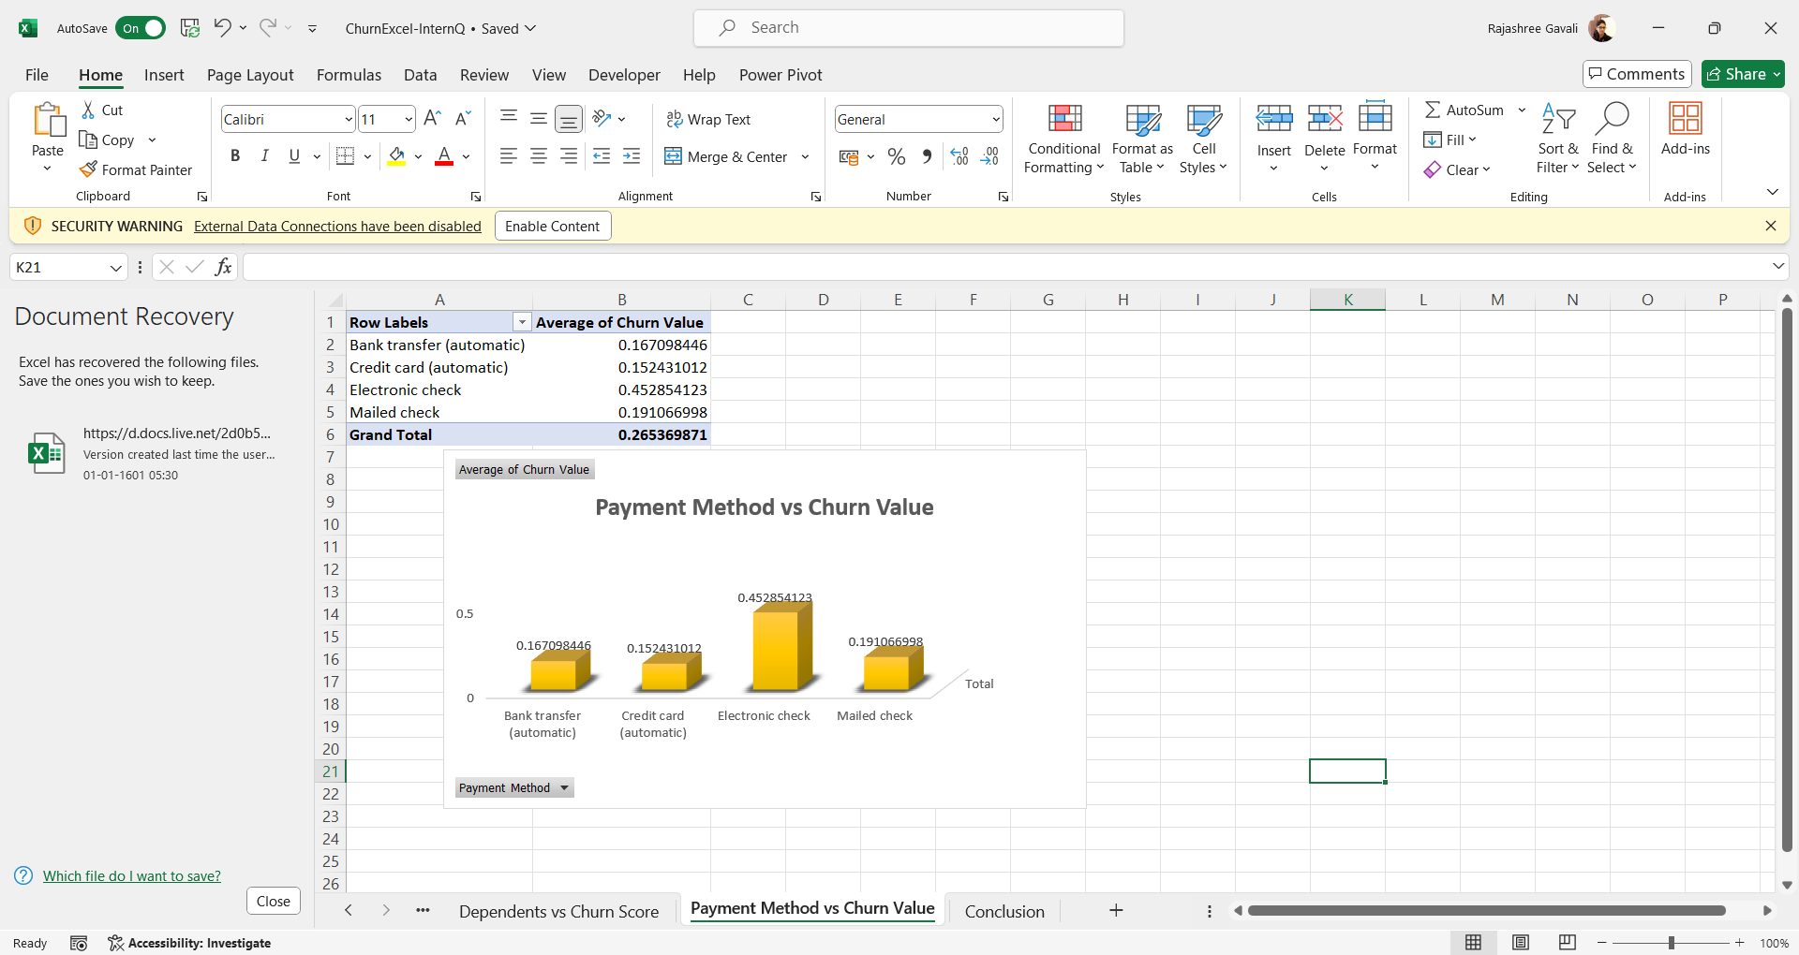
Churn by Payment Methods
Customers using Electronic check as their payment method have a higher churn value.

Slide 11
Conclusion from Excel Analysis
The key performance metrics are : Average Churn Score: $58.70, Average Monthly Charges: $64.76, Average Tenure months: 32.37
Churn Patterns:
Females exhibit a higher churn value compared to males.
Senior citizens have a higher churn value, while dependents show lower churn.
Month-to-Month contracts have the highest churn value.
Customers using Electronic check as their payment method have a higher churn value.

Slide 12

Data Analysis in Python
Data Loading & Preprocessing:
Loaded the cleaned data into Python using pandas.
The missing values from the Total charges columns was imputed using the fillna method.
Performed one-hot encoding on categorical variables.
Standardized numerical features for model training.

Slide 13
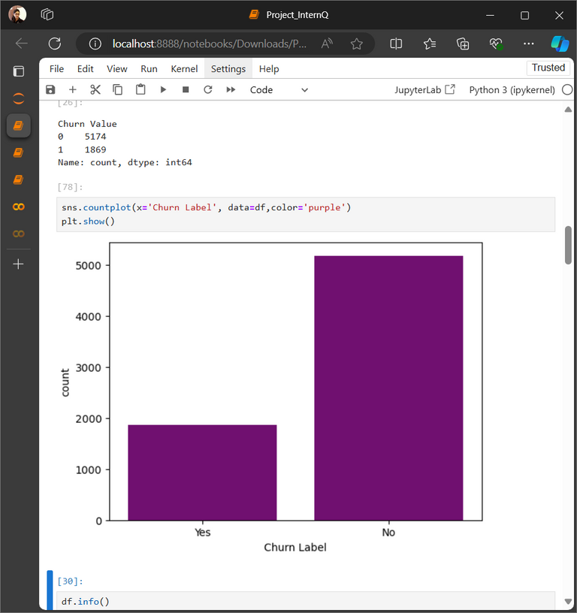
Count plot representing the Churn
A Count plot in Python, showed the dataset had less number of active churn. Thus, it is an imbalanced dataset and needs normalization to balance the dataset.

Slide 14
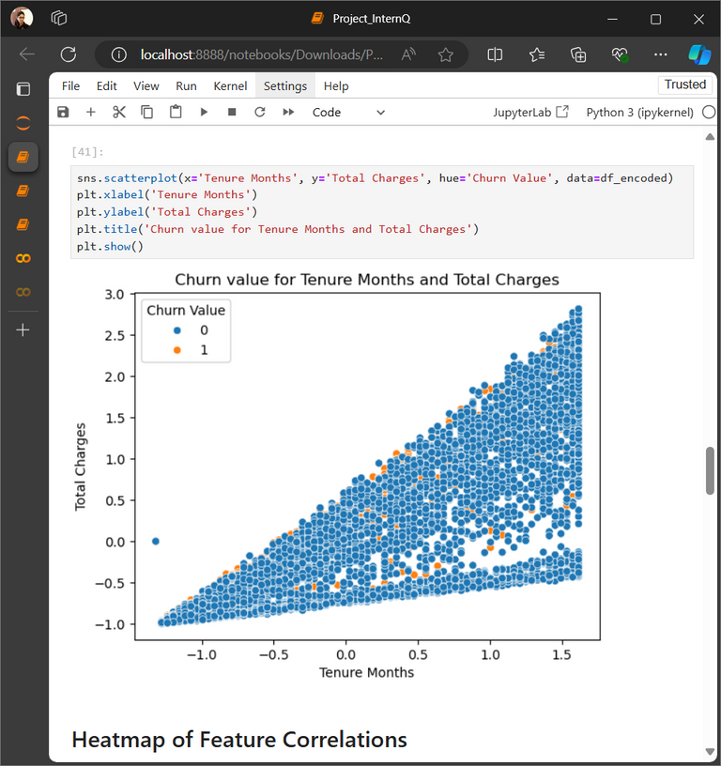
Scatter Plot of Tenure Months vs Total Charges
A scatter plot of Tenure Months vs Total Charges with respect to Churn value, showed linear relationship with each other and is almost directly proportional to the Churn value.

Slide 15
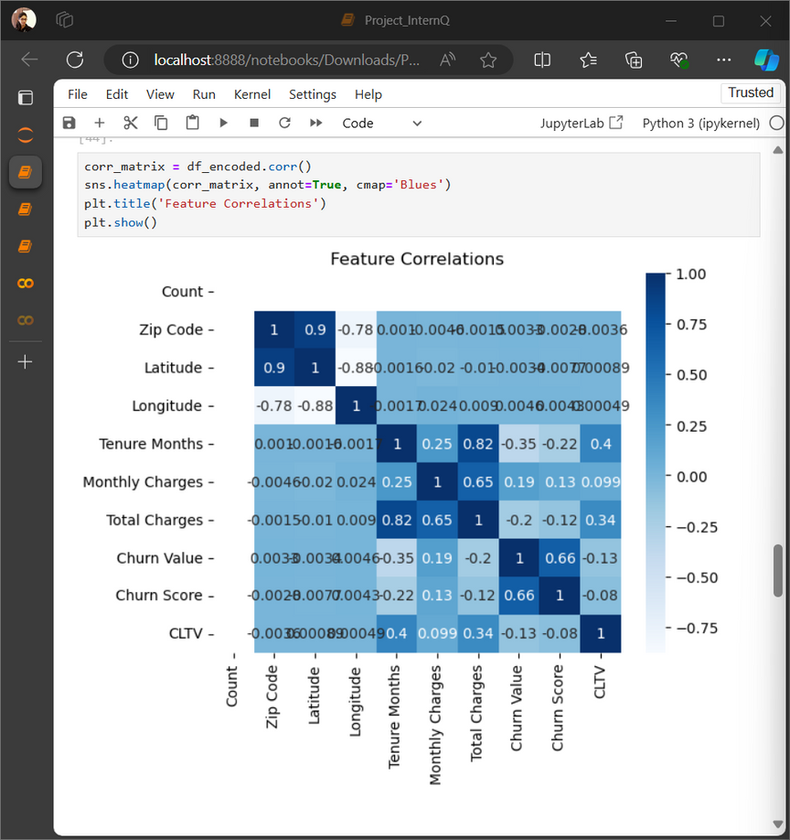
Heatmap of different features
Heatmap of different features shows, some of the features have a perfect relationship with each other.

Slide 16
Logistic Regression Model
A Logistic Regression model is built, with an accuracy 89% and precision 81% and ROC score of 96%.

Slide 17
Decision Tree Model
A Decision Tree model is built, with an accuracy 89% and precision 81% and ROC score of 96%.

Slide 18
Conclusion
Since both the models have same accuracy and precision score, any model can be chosen depending upon the business needs. But, a logistic regression model being a classification model is better suited for business purposed.
Offer personalized contract renewals or discounts for long-tenure customers.
Improve customer support for high-risk customer segments.
Implement targeted marketing campaigns based on churn risk.

Slide 19
Presented by Rajashree Gavali Kamble
THANK YOU
SO MUCH!

